Slide 1
GeekHub DS 2019 Challenge
InClass Prediction Competition:
Flower image classification
modeling using neural network
Filipov Vitalii

Slide 2
Tasks
Task is very simple - classification of flowers by using neural network.
Tasks to Do:
Image exploration and management
Image preprocessing
Load images
Splitting data
Image processing / file operations
Model selection
Modeling by NN
Analysis results
Submit data to Kaggle
Analysis results
2

Slide 3
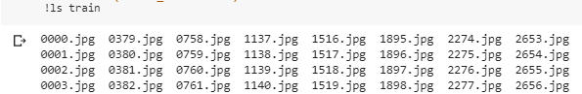
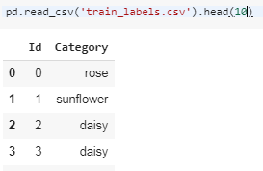
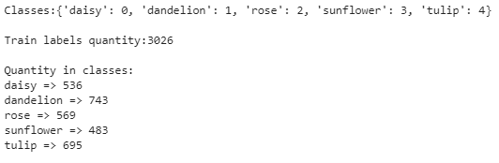
Image exploration and management
Load data from repository:
train.zip – 3026 files
test.zip – 1297 files
sample_submission.csv
train_labels.csv
Train data :
Train labels :
Image classes :
3

Slide 4
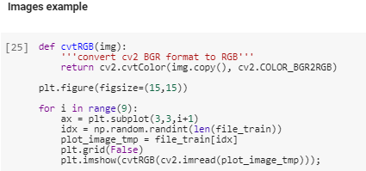
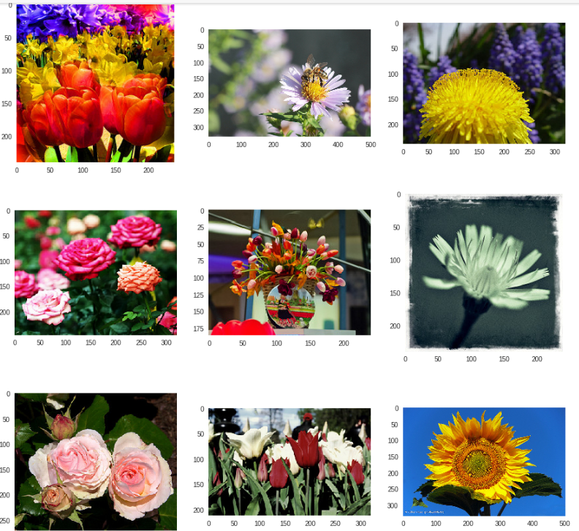
Load images
Examples of original images
by opevcv library:
4

Slide 5
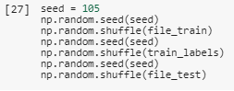
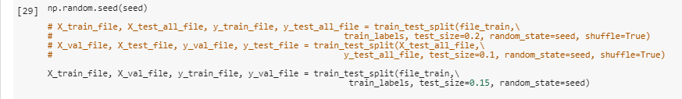
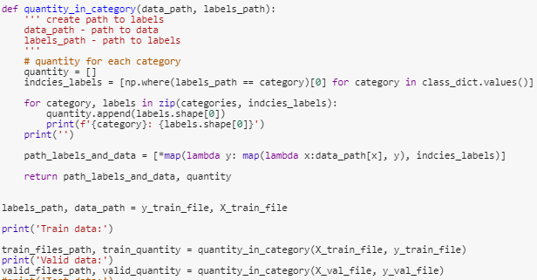
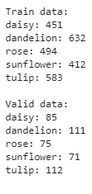
Splitting data
Shuffle data :
Splitting files for train and valid :
Path, quantity for train, valid data :
Quantity data
in categories :
5

Slide 6
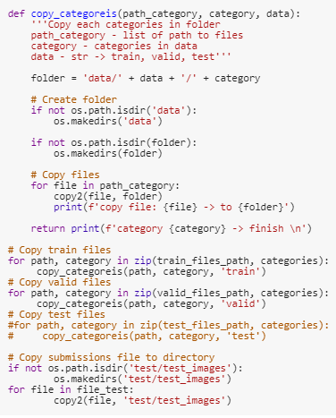
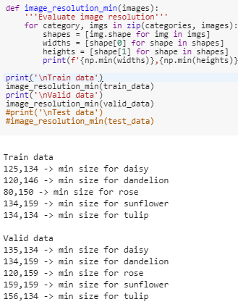
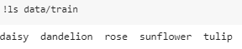
Image processing – file operations
Copy files to folders :
Minimal image resolution
Result folders :
6

Slide 7
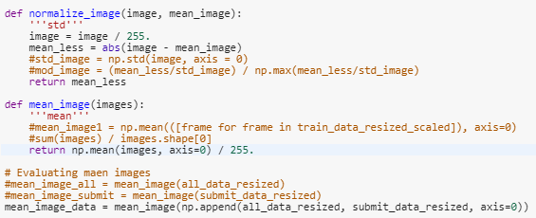
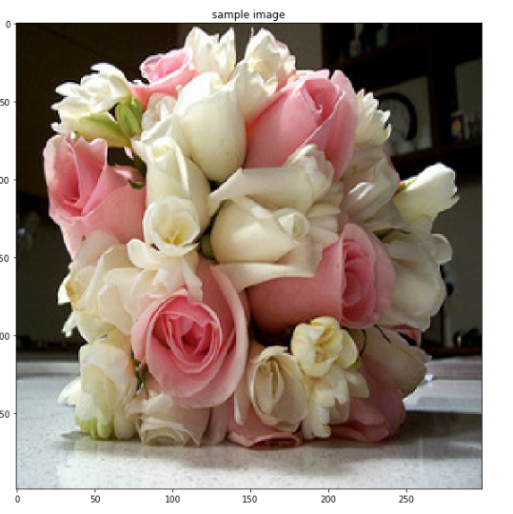
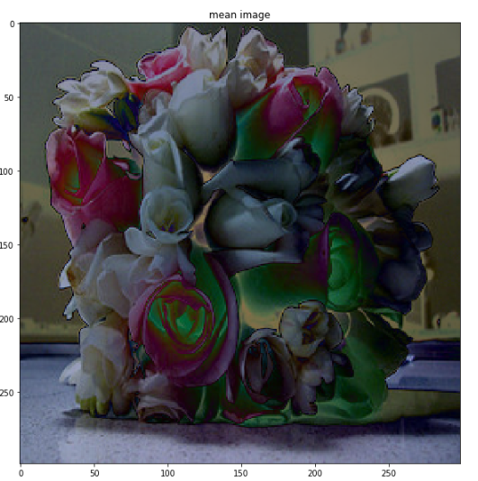
Image preprocessing - normalization
Normalize images :
7

Slide 8
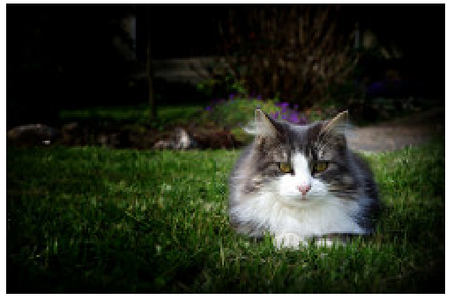
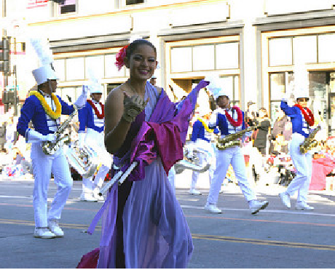
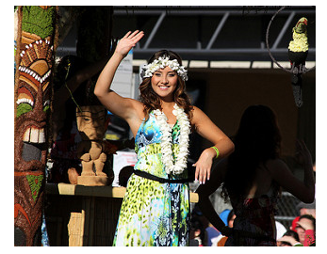
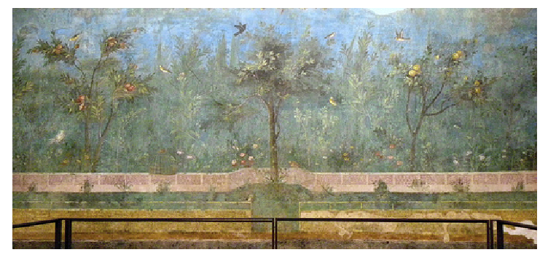
Image preprocessing – problem images
Daisy?!
Rose?!
Rose?...
Roses…
8

Slide 9
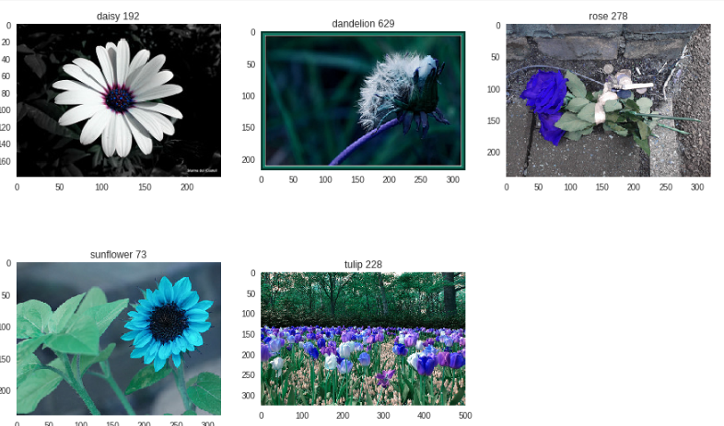
Image preprocessing – after normalization
9

Slide 10
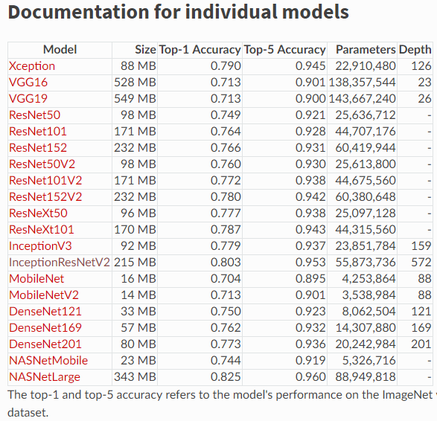
Model select
https://keras.io/applications/#inceptionresnetv2
10

Slide 11
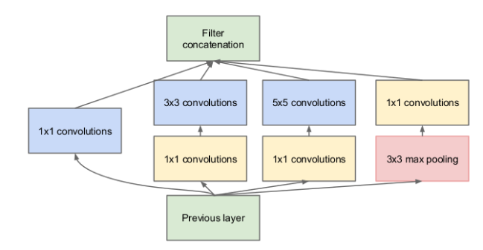
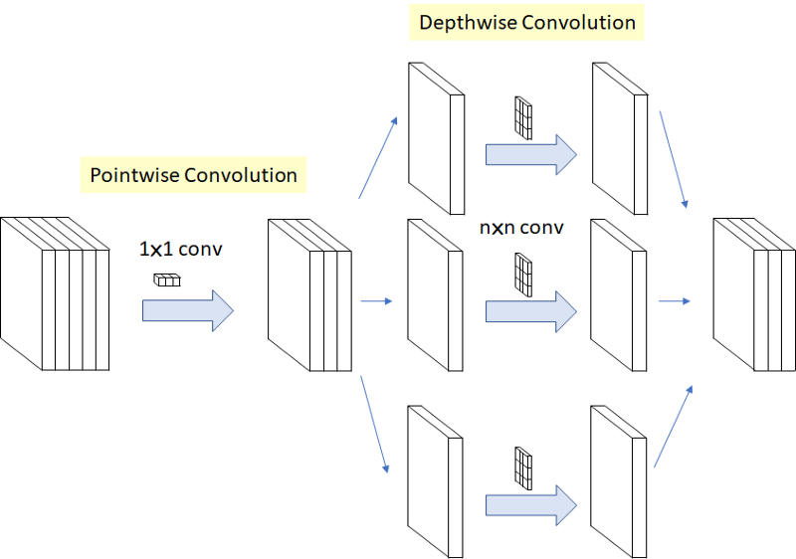
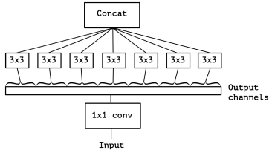
Model Xception
2016 François Chollet
full module Inception network
Xception
Inception https://www.cv-foundation.org/openaccess/content_cvpr_2015/papers/Szegedy_Going_Deeper_With_2015_CVPR_paper.pdf
Xception https://arxiv.org/pdf/1610.02357.pdf
https://habr.com/ru/post/347564/ https://github.com/hokmund/xception-transfer-learning/blob/master/transfer-learning.ipynb
https://towardsdatascience.com/review-xception-with-depthwise-separable-convolution-better-than-inception-v3-image-dc967dd42568
11

Slide 12
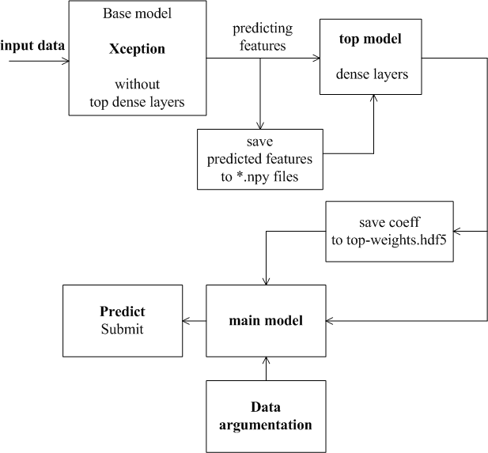
Modeling structure
12

Slide 13
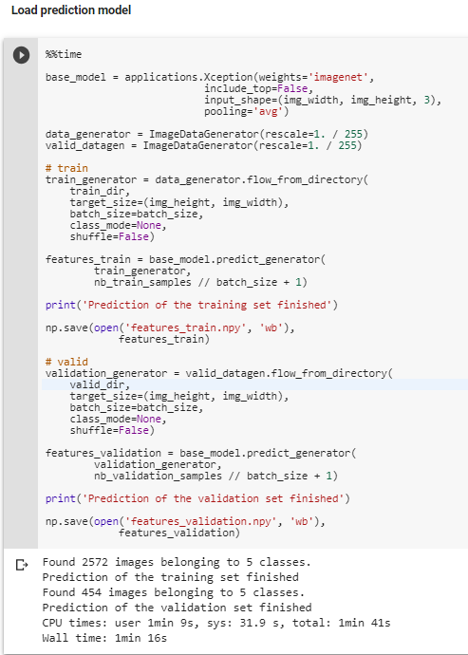
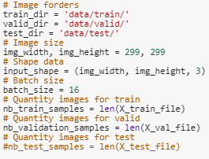
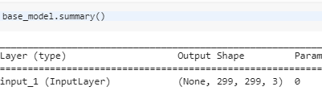
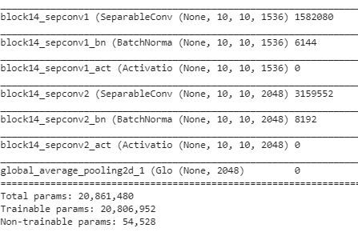
Model Xception
Base model
Input data:
13

Slide 14
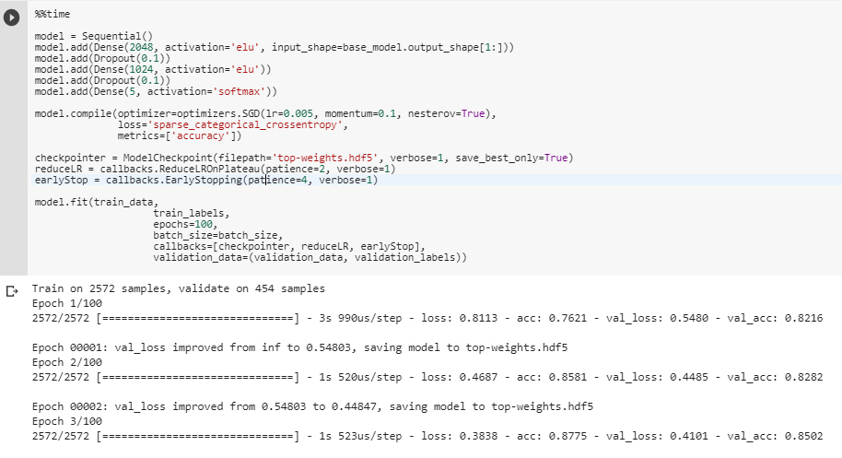
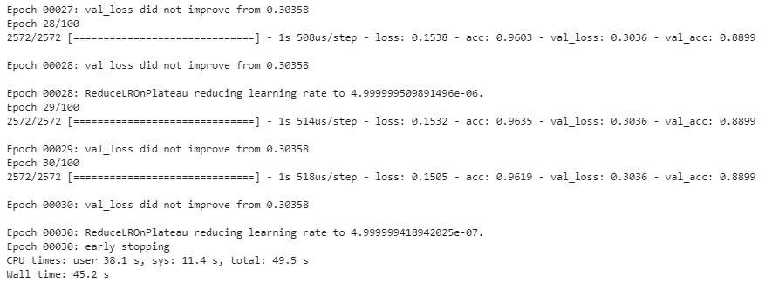
Model Xception - Top (dense) layers
14

Slide 15
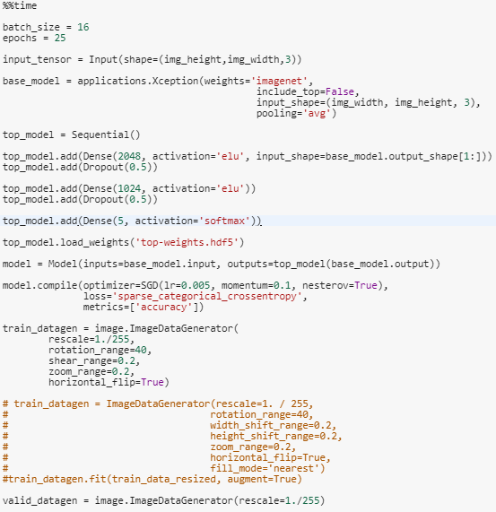
Model Xception – Main model
Main features :
2-level dense layres
Dropout layres
Activators: ‘relu’/ ‘elu’
Optimizator: SGD
Data argumentation
15

Slide 16
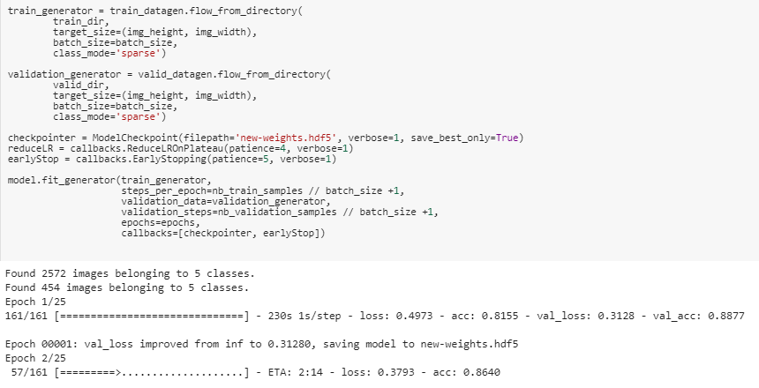
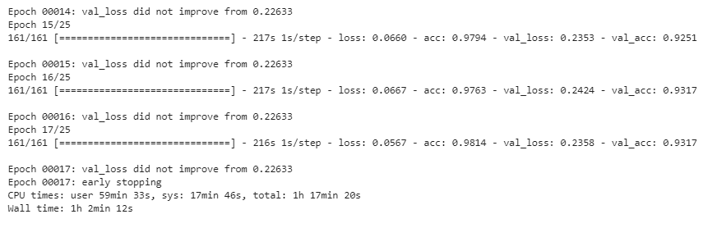
Model Xception – Main model
16

Slide 17
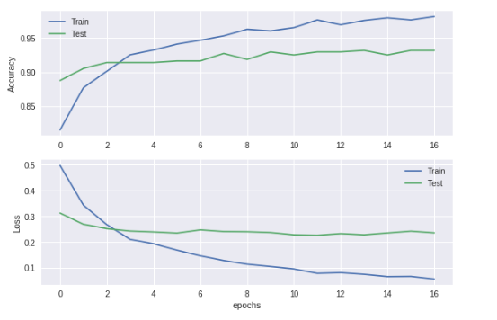
Learning Curves
17

Slide 18
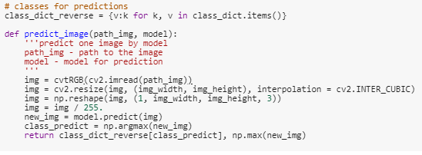
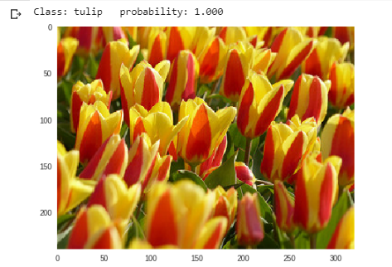
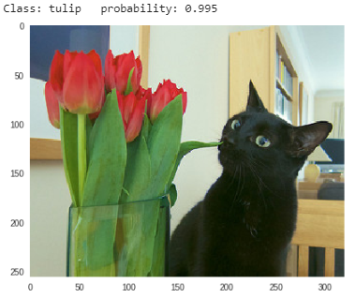
Predict image class
Function for predict
Predicted class and probability for random image (test folder)
18

Slide 19
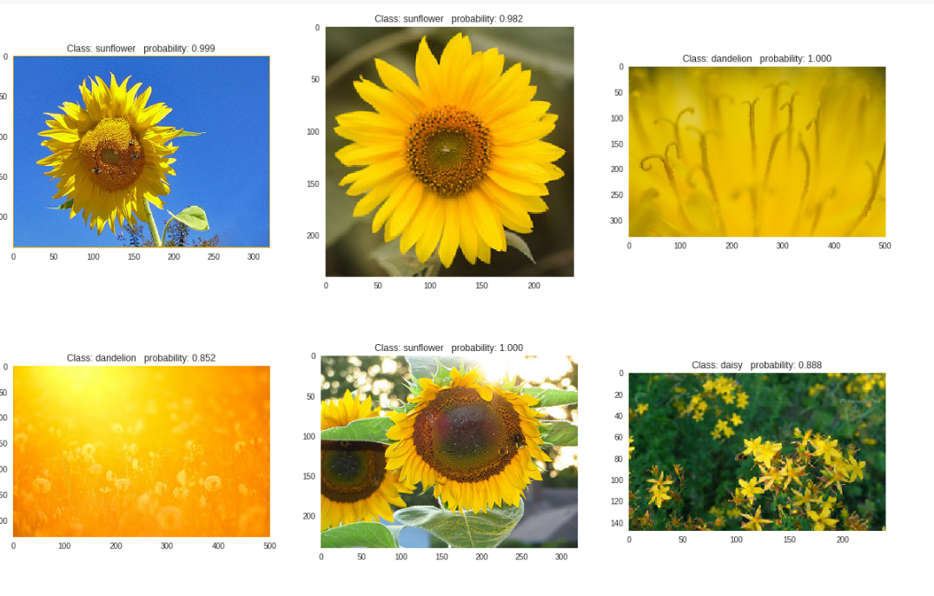
Predict image class
19

Slide 20
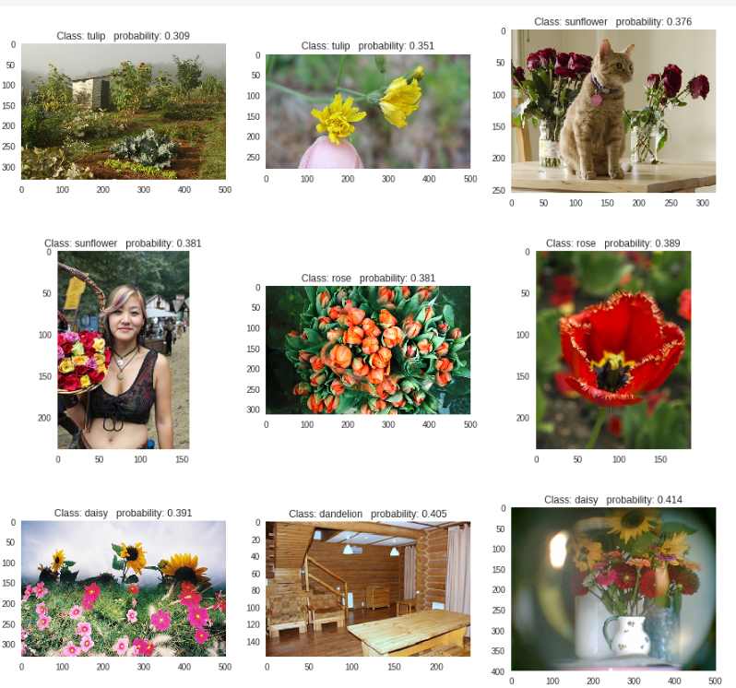
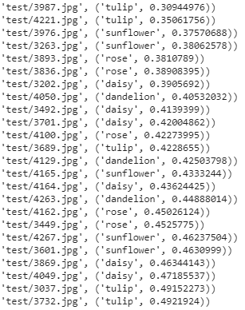
Predict image class (test)
low probability
less 50%
20

Slide 21
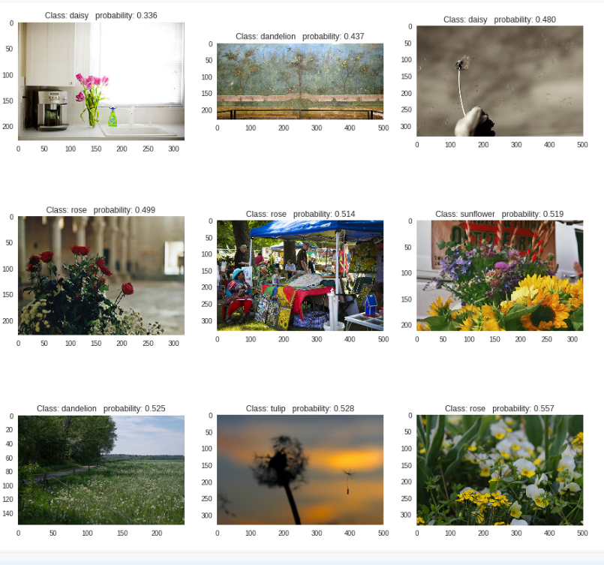
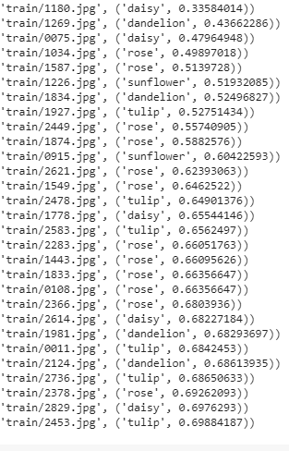
Predict image class (train)
low probability
less 60%
21

Slide 22
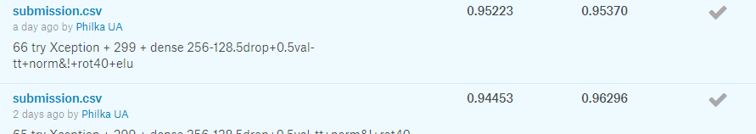
Result:
That’s all for today ;)
Image normalization https://colab.research.google.com/drive/1IZEyIORa4sDgBkxU9NV-hJLNfZMWMg8u
Main notebook https://colab.research.google.com/drive/1WTWKY0S19cKBKYKuv2_9juTHCNyKSfVv

